Slide 1
Machine Learning in Breast Cancer Test-Result Visualisation
By
Saurabh Kumar
Reg No:-
181040110274
Roll No: 10400218048
Under the guidance of
Prof. Subhabrata Sengupta
Department of Information Technology
Institute of Engineering and Management

Slide 2
Problem Definition:
If a girl/women is affected with any types of Lumps in her breasts and after performing different tests like mammogram and breast ultrasound as well as Breast MRI, PET/CT etc tests and she gets positive result and treatment involves some unexpected incident then we try to finds some more justification as the incident happened to me is all right or report was wrong like that. they starts to doubt the report.
Aim & Scope:
To Build a Machine Learning Model which can predict the possibility of developing cancer from the lumps/Tumour so that without involving any further human effort my model can tell the humans about they have Breast Cancer or Not.

Slide 3
Introduction
In this Project titled “Machine Learning in Breast Cancer Test-Result Visualisation”, I am trying to predict the type of Lump/Tumour developed in Female Breast as it is Non-Cancerous (Known as Benign) or Cancerous (Known as Malignant), with the help of One of Today’s Advance Technology Known as Machine Learning So that it can be cared off accordingly.

Slide 4
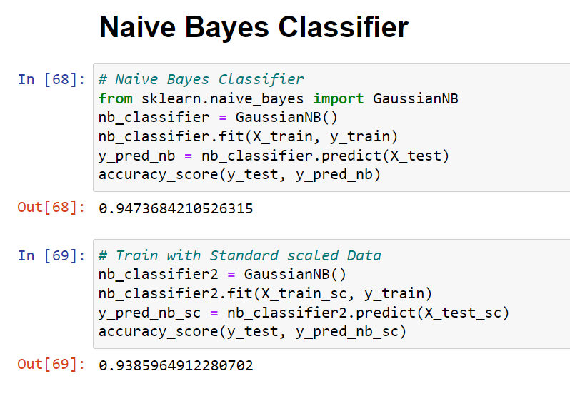
NAIVE BAYES CLASSIFIER MODEL

Slide 5
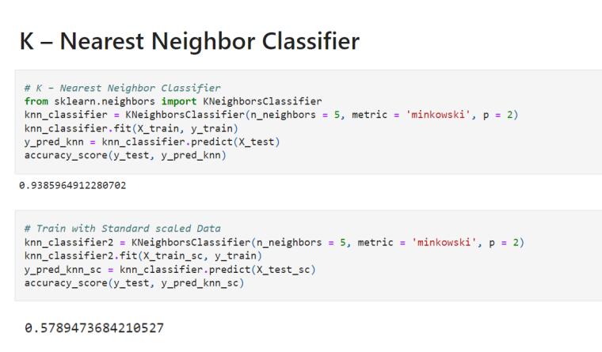
K NEAREST NEIGHBOUR MODEL

Slide 6
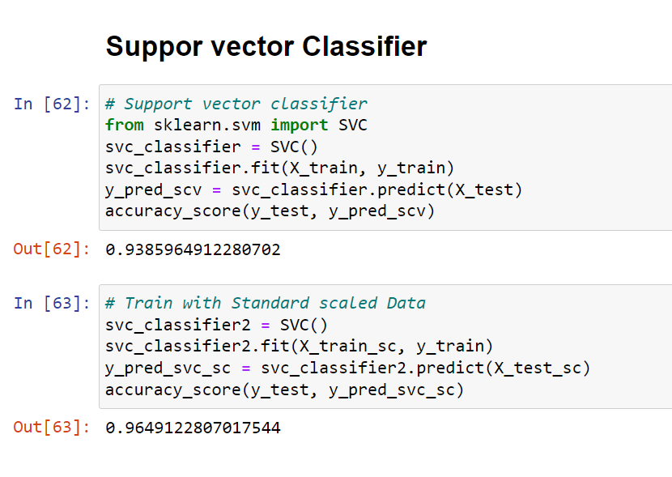
SUPPORT VECTOR MACHINE

Slide 7
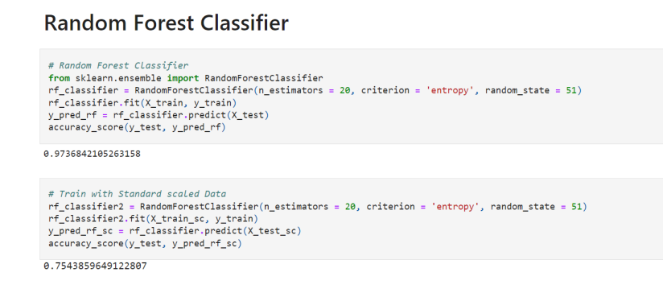
RANDOM FOREST CLASSIFIER

Slide 8
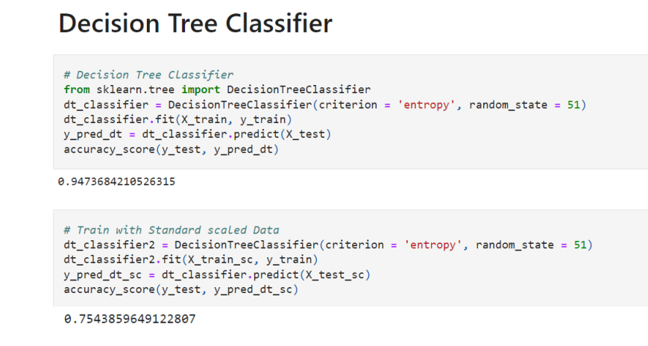
DECESION TREE CLASSIFIER

Slide 9
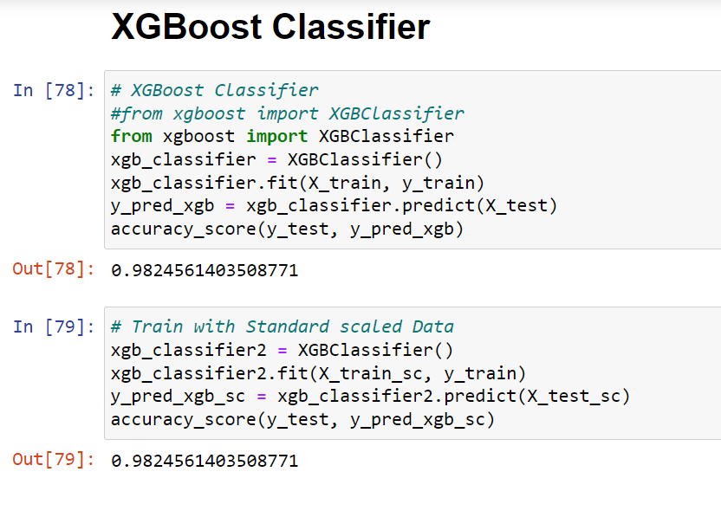
XgBoost Classifier Model

Slide 10
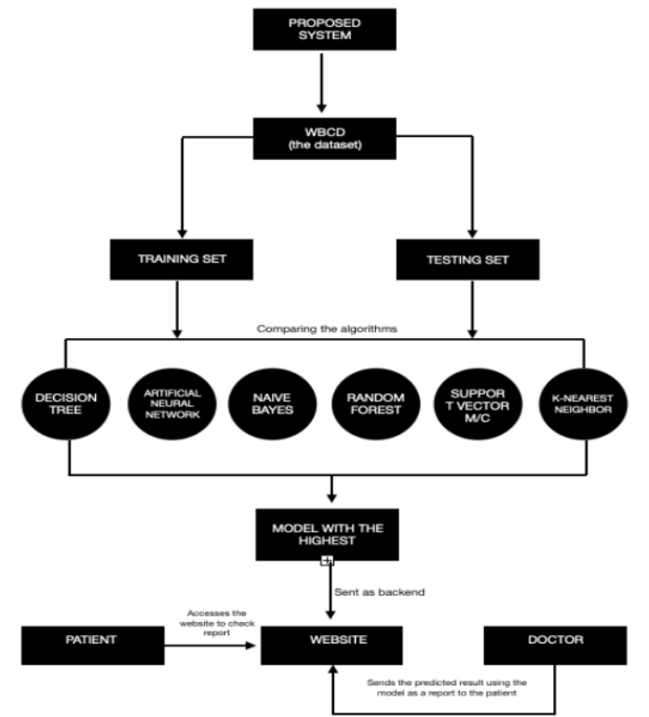
Future Scope

Slide 11
THANK YOU

